Slide 1

The Overfitters
EDA TASK
By : Youssef & Jolie & Shika

Slide 2
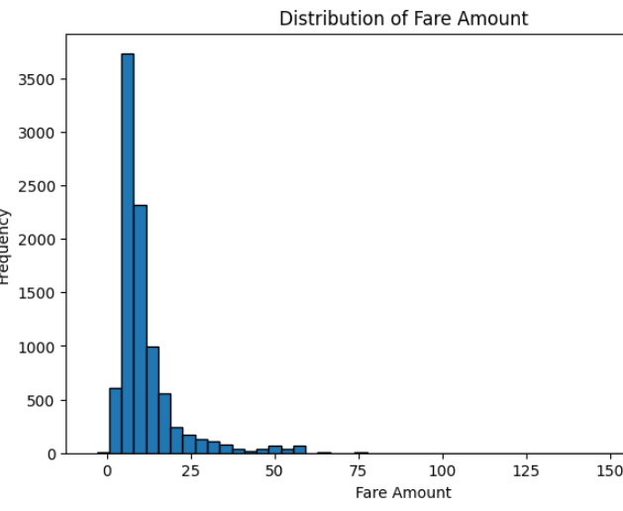
Distribution of Fare Amount
The highest frequency is between $5–15, which likely represents typical short intra-city rides
This indicates that the platform’s core demand is for short, affordable rides
The company might optimize pricing or loyalty programs around this segment

Slide 3
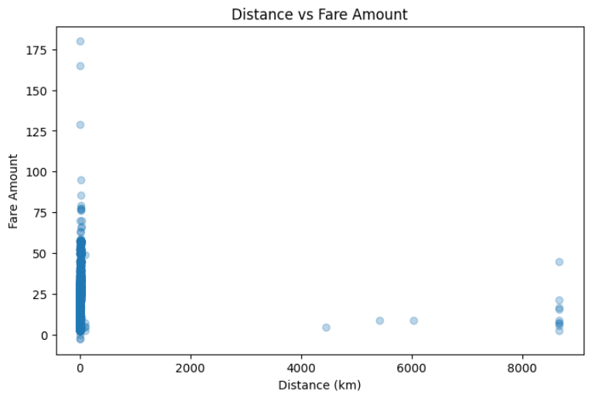
Distance vs Fare Amount
The more distance increase, the more fare amount increase
we have some outliers in distance 8000+ and the issues is its fare amount is very low from 1$-50$ so it can be entered by error

Slide 4
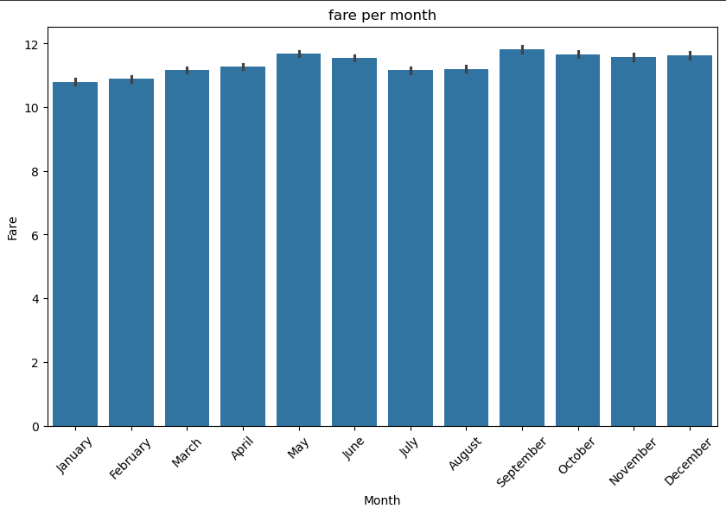
Fare per month
The chart is a bar graph showing the fare per month across a year.
January and February are the months with the lowest fares
There seems to be a slight increase in fares around late spring (May) and early fall (September)

Slide 5
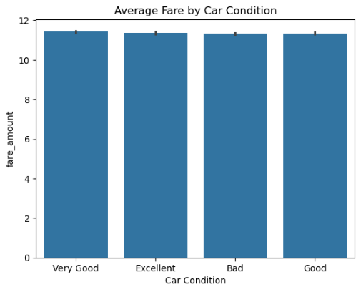
Average Fare by Car Condition
Car condition doesn't affect the fare
The company maybe can make different fares depends on the condition of the car

Slide 6
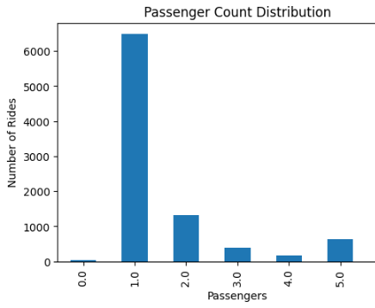
Passenger Count Distribution
Most of the rides has one passenger only
The rides has 6 only very low , it can be that we have few cars their max capacity is 5

Slide 7
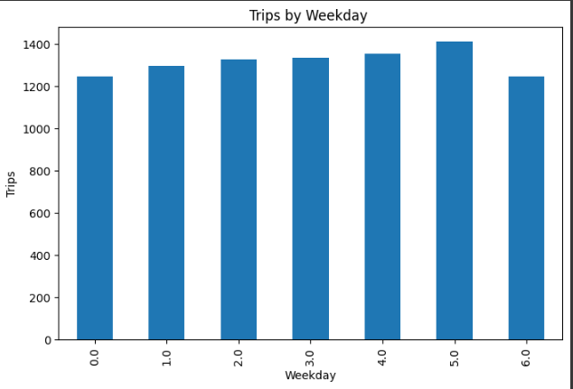
Trips by Weekday
Most day that has rides is Friday
0 starts from sunday

Slide 8
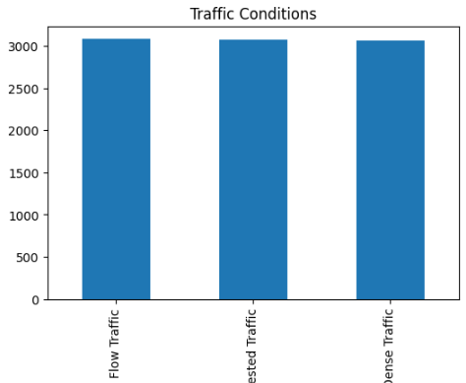
Traffic Conditions
Since all conditions are represented equally, there isn’t one traffic state that is more common than the others
All three traffic conditions—Flow Traffic, Congested Traffic, and Dense Traffic—have nearly identical values, around 3,100

Slide 9
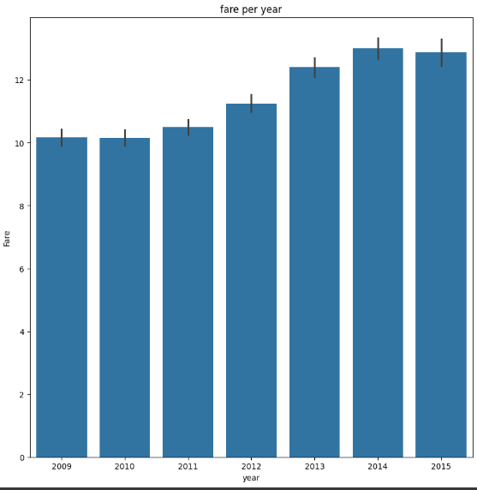
Fare per Year
The avg increased after 2012

Slide 10
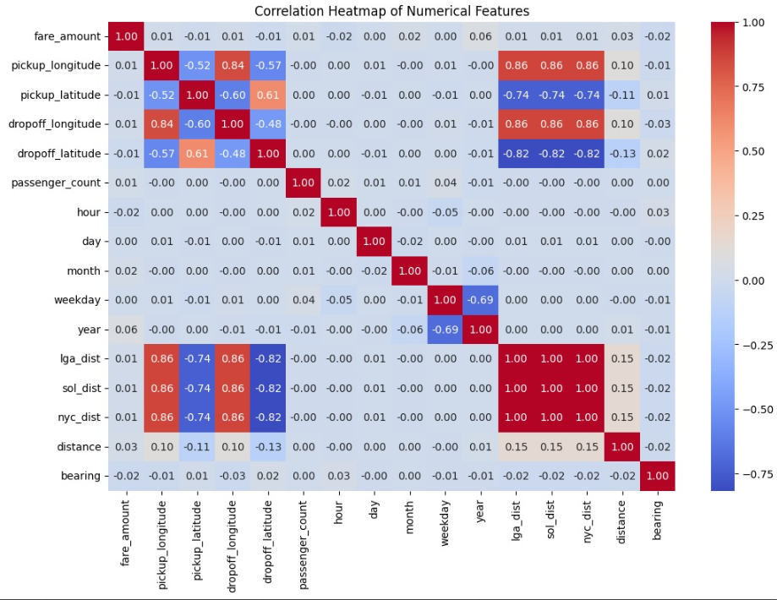

Slide 11


The Overfitters

